Slide 1
National Day for Truth and Reconciliation
Orange Shirt Day
September 30th, 2022
Lesson adapted from: Orange Shirt Day Toolkit, Gillian Murr and Jeidah DeZurney
Notes:
Lesson mentions different kinds of abuse on slide 5

Slide 2
Orange Shirt Day was created as an opportunity to discuss the effects of residential schools and their legacy. It honors the experiences of Indigenous Peoples, celebrates resilience and affirms a commitment that every child matters.

Slide 3
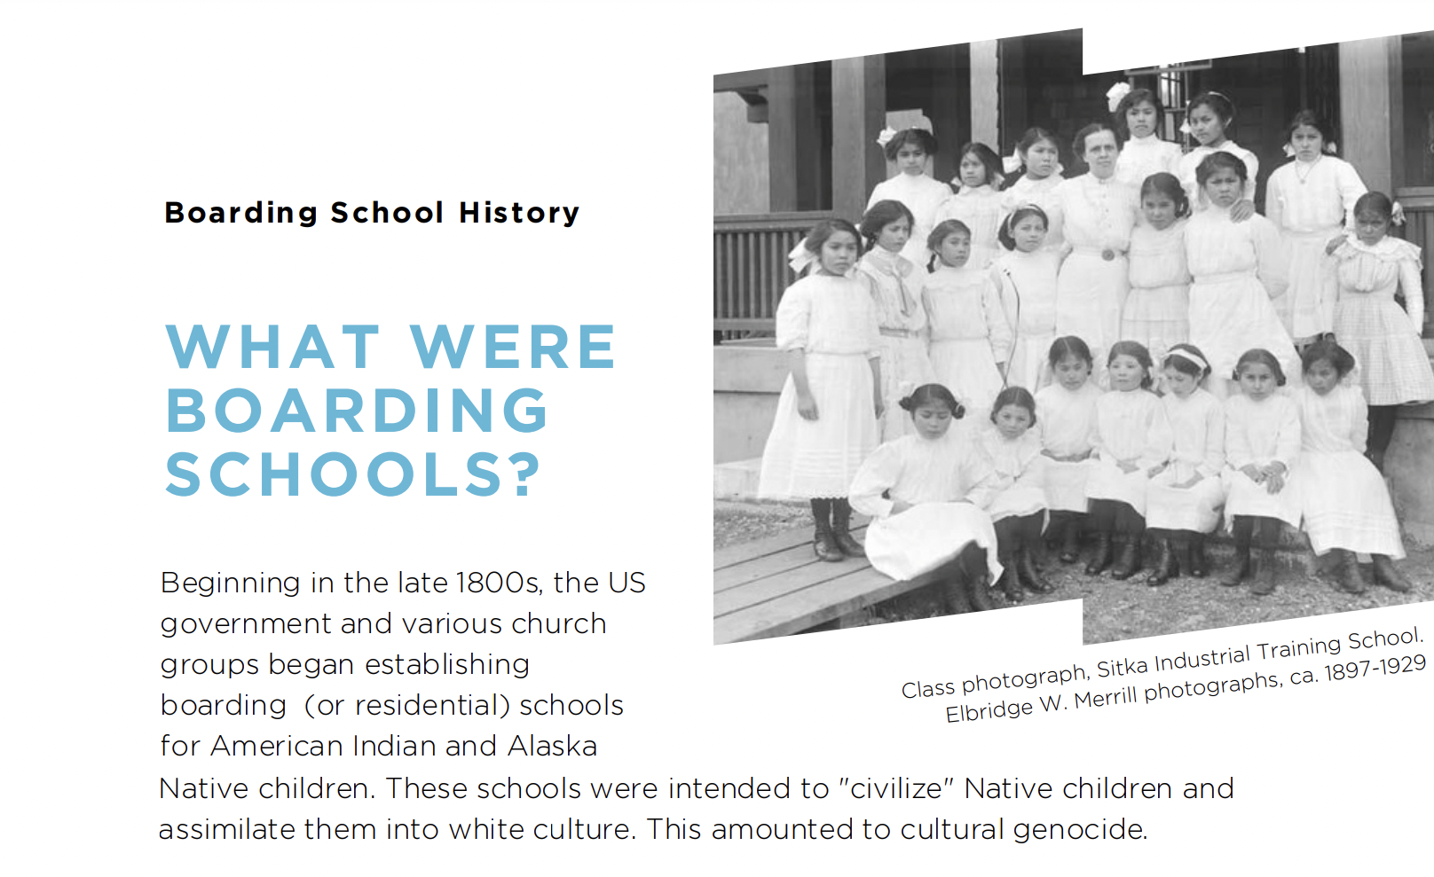
Notes:
Orange Shirt Day Toolkit

Slide 4
What were these schools like?
Native children were forcibly removed from their families and communities and compelled to attend boarding school, where they were prevented from speaking their Native languages, practicing their religions, and engaging in cultural practices and traditions. They were often assigned numbers instead of names and forced to wear Western clothing.

Slide 5
What were these schools like?
Boarding school rules were enforced through corporal punishment including solitary confinement, flogging, withholding food, whipping, and slapping. Physical, sexual, and emotional abuse, as well as disease, neglect and malnourishment, were rampant at these institutions. When children died at school as a result, they were often buried in unmarked graves far from home. Their families were not always informed of what had happened to their children.

Slide 6
Vocab
ACTION Participate in Orange Shirt Day with an activity to recognize boarding school survivors, remember the children who never came home, and work to create an community that celebrates and honors Native children and communities
TRUTH "That which corresponds to reality"
Teach the truth of what happened at boarding schools Teach the truth of why it happened
RECONCILIATION "Restoring positive relationships"
Teach about how the history of boarding schools still impacts Native communities today
Listen empathetically to Native voices - ensure your teaching materials include Native sources
Take positive action for the future

Slide 7
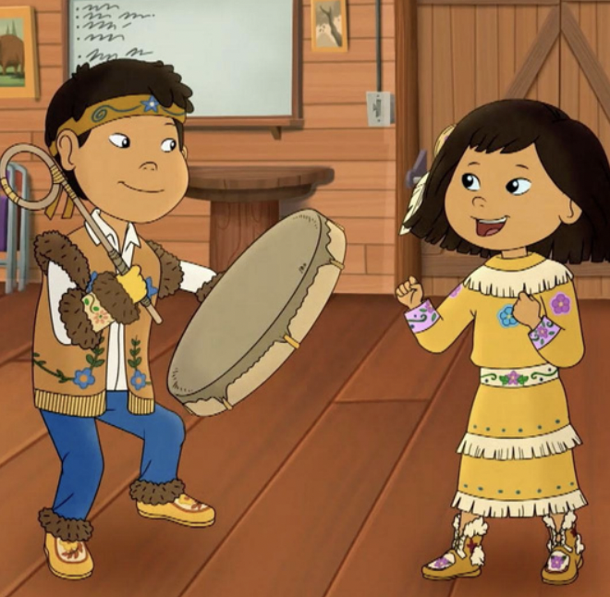
Younger Students-Grandpa’s Drum, Molly of Denali
Truth
Molly learns her grandpa and other children were not allowed to sing their songs or speak their language at school.
How do you think this made Grandpa Nat feel?
How has Grandpa Nat's time at school impacted his life?
Notes:
Watch the Molly of Denali clip and then have the students reflect

Slide 8
Younger Students-Grandpa’s Drum, Molly of Denali
Reconciliation
What happens when Molly returns Grandpa Nat's drum?
How is Molly's experience different than Grandpa Nat's when he was her age?
How is Grandpa Nat's experience in school different than yours?

Slide 9
Younger Students-Grandpa’s Drum, Molly of Denali
Action
Phyllis Webstad, founder of Orange Shirt Day, has a similar story to Grandpa Nat.

Slide 10
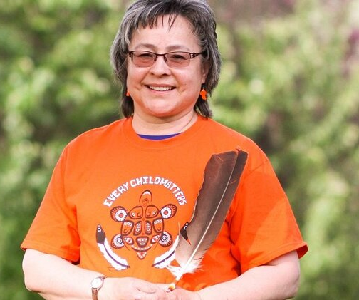
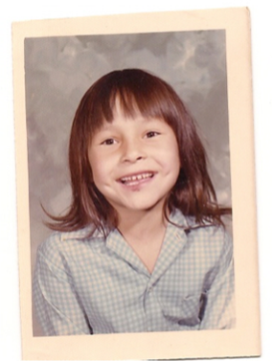
Why Orange Shirts?
Orange Shirt Day references a real orange shirt taken from a residential school survivor.
Now an adult, Phyllis Webstad still remembers the new orange shirt that her grandmother bought for her when she was six years old. She wore it proudly on her first day at a church-run residential school in Williams Lake, B.C. But then school authorities stripped her of her clothes, cut her hair and took her shirt away. She never got it back.
“The colour orange has always reminded me of how my feelings didn’t matter, how no one cared,” she writes. “I went to a treatment centre for healing when I was 27 and have been on this healing journey since then. I finally get it, that the feeling of worthlessness and insignificance, ingrained in me from my first day at the mission, affected the way I lived my life for many years.” - Phyllis Webstad (Beyond UBC)

Slide 11
Action What can I do ?
Print out the Orange Shirt Day coloring page. Have students brain storm ways that they matter to fill in the sentence frame.
Notes:
Feather coloring page and other coloring pages: Orange Shirt Day Toolkit

Slide 12
Older Students-Grandpa’s Drum, Molly of Denali
Vocab
Cultural assimilation: The process through which an individual or community takes on the values, beliefs, and behaviors of another group. Assimilation can be voluntary or forced.
Cultural genocide: A particularly extreme form of cultural assimilation that involves the deliberate and systematic destruction of a culture. The goal of cultural genocide is to eliminate the culture entirely.
Colonialism: The domination of a people and/or territory by another group in order to exploit the colonized group's labor, land, or resources.

Slide 13
Older Students-Grandpa’s Drum, Molly of Denali
TRUTH
Molly learns her grandpa and other children were not allowed to sing their songs or speak their language at school. In one scene, Shyahtsoo's doll is taken away and replaced with another doll.
Think about the difference between the two dolls. What does the difference between the dolls reveal about boarding schools and what they taught Native students?
Notes:
After students have had the chance to share their thoughts, use the before & after lesson to further explore the impact of boarding schools through visual imagery.

Slide 14
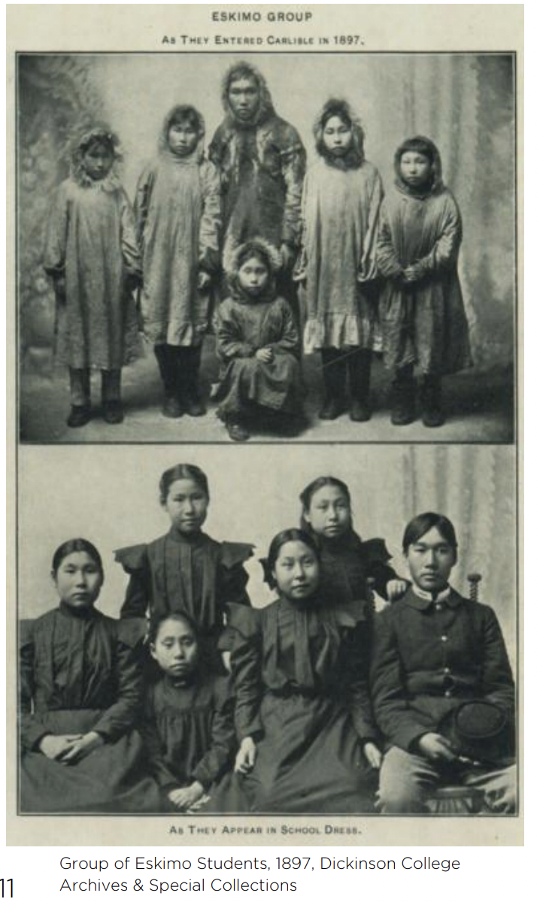
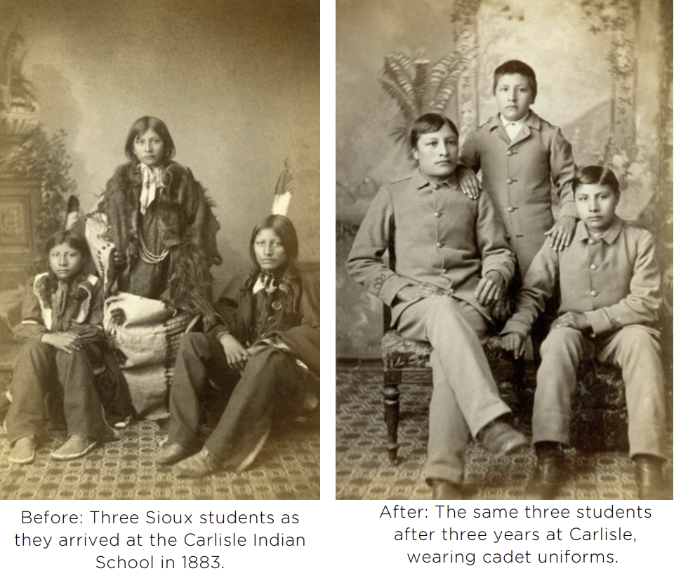
Older Students-
What do you observe in these photos?
What are the differences between the before & after photographs?
What do you think happened in between these two photos?
What do you think the purpose of these photos was?
What do these photos convey about the purpose of US Indian boarding schools?

Slide 15
Older Students-Grandpa’s Drum, Molly of Denali
RECONCILIATION
Think about the type of doll Shyahtsoo's granddaughter is seen playing with.
What does this show about how things have changed since Shyahtsoo was a child?

Slide 16
Older Students-Grandpa’s Drum, Molly of Denali
ACTION
Preserving and celebrating Native culture today is one of the best ways to reverse the cultural assimilation and genocide of the boarding school era.
What are some ways people can protect, preserve, and honor Native culture today?

Slide 17
Action What can I do ?
Print out the Orange Shirt Day coloring page. Have students brain storm ways that they matter to fill in the sentence frame.
Notes:
Feather coloring page and other coloring pages: Orange Shirt Day Toolkit

Slide 18
Other Possible Activities
Poem and analysis: I Lost My Talk by Rita Joe

Slide 19
We encourage you to wear orange on Friday, September 30th 2022 to remember the lost Native American/Indigenous children sent to residential schools and to honour the survivors, their families, and their communities.

